Slide 1
Series: Two
Webinar: Two

Slide 2
Are you an influential leader?
Are you willing to test yourself?
  Quick
  Easy
  Fun
Self! Customers! IBO’s!

Slide 3
How leadership works:
X Information
Ideas
Inspiration
Influence

Slide 4
Time to Act!

Slide 5
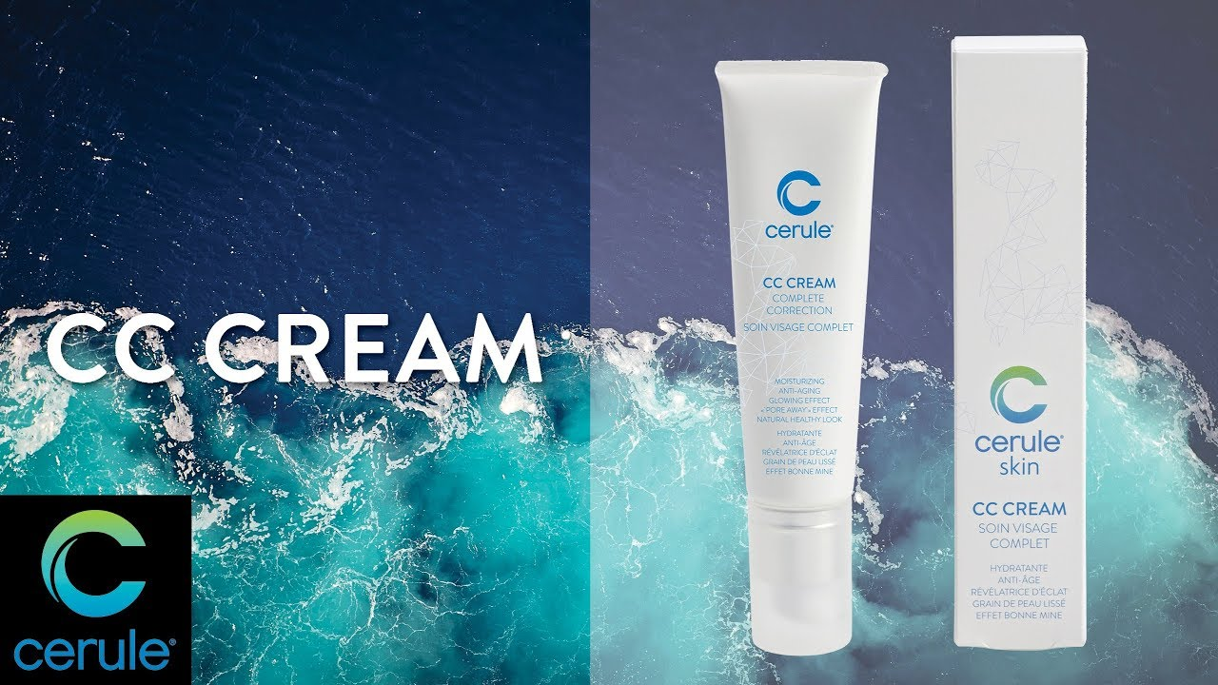

Slide 6
Introducing.... My miracle product...
Instant neck lift!
Jade and Tania’s date night secret!
Dare to bare!
  Younger skin in seconds
  Smooths
  Softens
  Blends
  Camouflages
  Reflects flaws - harsh light and night!

Slide 7
It’s time to blitz your business!
Short-term sales boost
Long-term customer
A new IBO
Recognition and rewards from Cerule
Anyone can make the top ten!
  AU/NZ!
  Rest of world!

Slide 8
We provide you drive!
TWO FOR ONE!
FORTY-EIGHT HOURS ONLY!

Slide 9
Call everyone
Text/pm everyone
Promote on social media pages (and follow up!!)

Slide 10
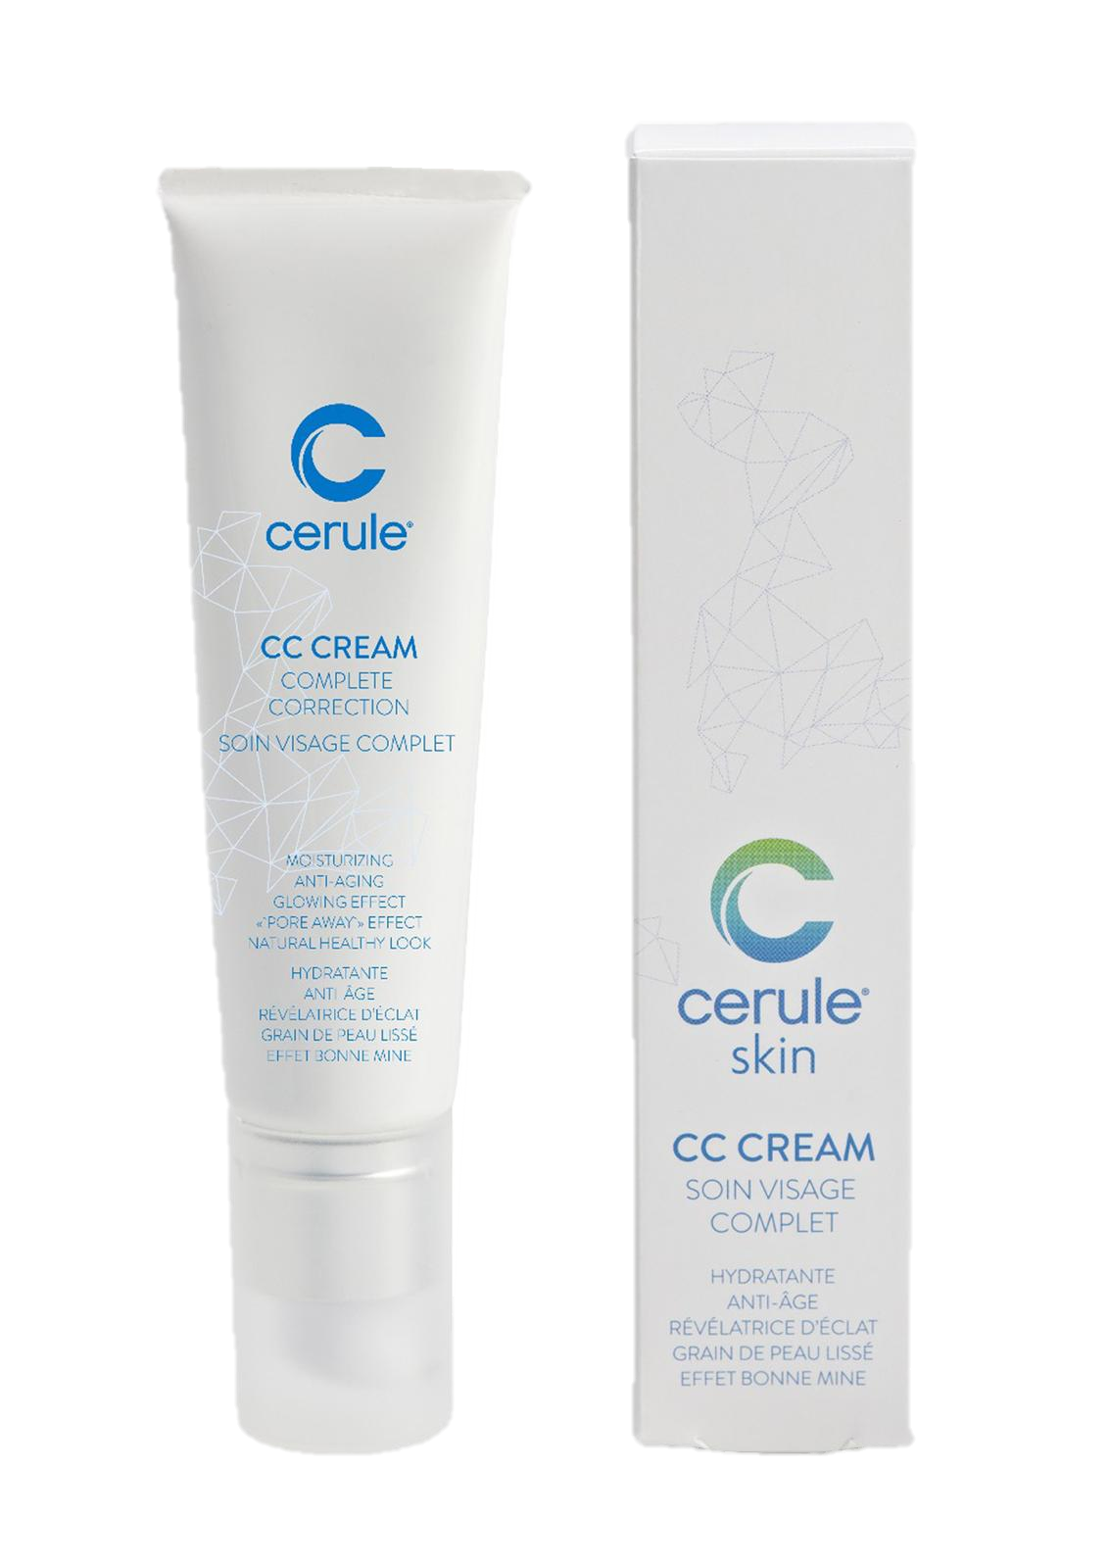
USA
BUY ONE GET ONE FREE ends Thursday 7pm PST
(Your team must call Cerule Services and referrer your name to get the deal)

Slide 11
Australia
BUY ONE GET ONE FREE ends Friday 12pm EST (QLD)
(Your team must call Cerule Services and referrer your name to get the deal)

Slide 12
New Zealand
BUY ONE GET ONE FREE ends Friday 2pm
(Your team must call Cerule Services and referrer your name to get the deal)

Slide 13
Sell don't tell!
Make it personal
  The reason I love CC cream is....
  The difference CC cream makes for me is....
Sell the results!
  Your neck will look softer, younger, and more glowing.
  You’re going to tell me this is the best product you’ve ever used.

Slide 14
Be in to win!
Top seller will win 3 FREE Instant Tensor Serum

Slide 15
Visualize this response…
Customers:
I want this
I need this
This is too good to resist – I’ll buy two and get four!
I could sell this!
IBO’s
I’m running with this!
I’m in it to win it!

Slide 16
Did I succeed?
Did I give you a great idea (SPARK!)
Are you inspired to ACT?
Did I influence you to:
  Work the 48- hour sale
  Rally your IBOs
  Start NOW!!
Find out next week...

Slide 17

How leadership works:
Ready... set.... go!

